Slide 1
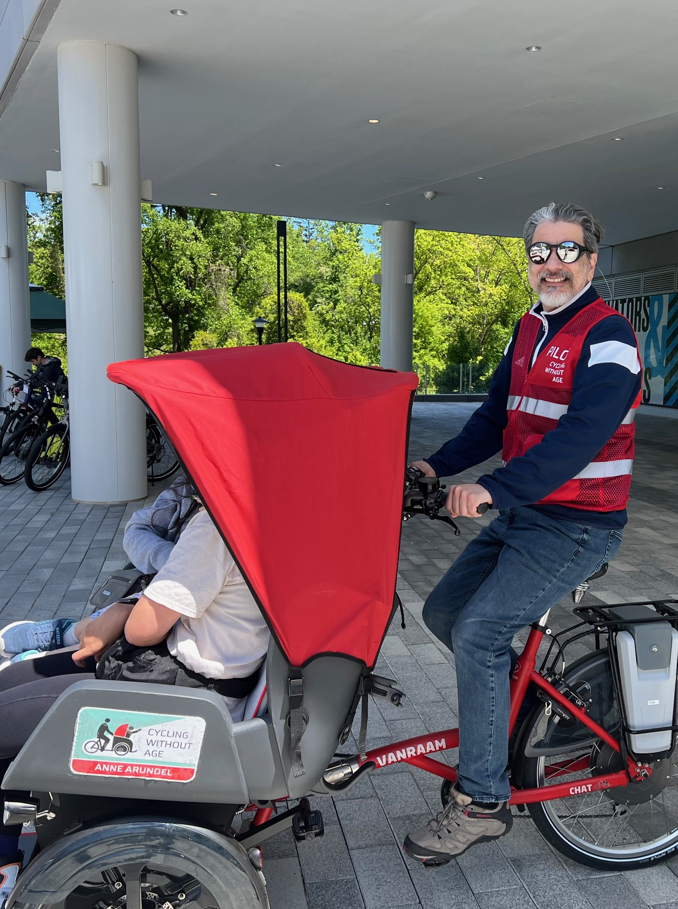
Welcome to Cycling Without Age Howard County chapter (CWA HoCo)!
My name is Juan Albertorio. I am a 50+ resident of Howard County (HoCo), Maryland, and an advocate for social connection programs for our 50+ residents, Veterans, and residents with limited mobility. I am here to bring cycling without age to HoCo!
What is Cycling Without Age?
Cycling Without Age is a movement in where we believe that everyone is an agent of change and deserves the joy of cycling, regardless of age or mobility. Our program is dedicated to providing residents aged 50 and above, veterans, and individuals with limited mobility the opportunity to experience the freedom and exhilaration of cycling through our specially designed trishaws and with our volunteers. Join us in promoting a healthier, happier HoCo community where every ride helps us foster civility, enhance our social connections, and bring smiles and connections to our residents.

Slide 2
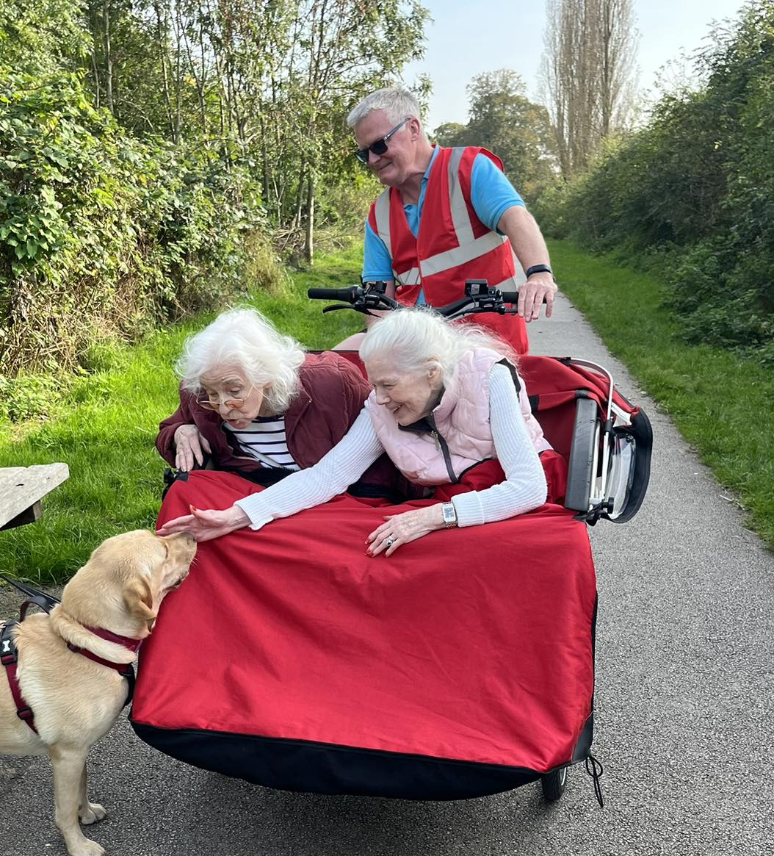
What CWA HoCo provides?
Trishaw Rides: Enjoy free scenic rides around your neighborhood or local parks in our comfortable trishaws, piloted by trained volunteers.
Community Engagement: Connect with fellow residents and volunteers who share a passion for human connection, community service, and wellbeing.
Social Interaction: Meet new friends and strengthen existing relationships while enjoying the great HoCo trails and outdoors.

Slide 3
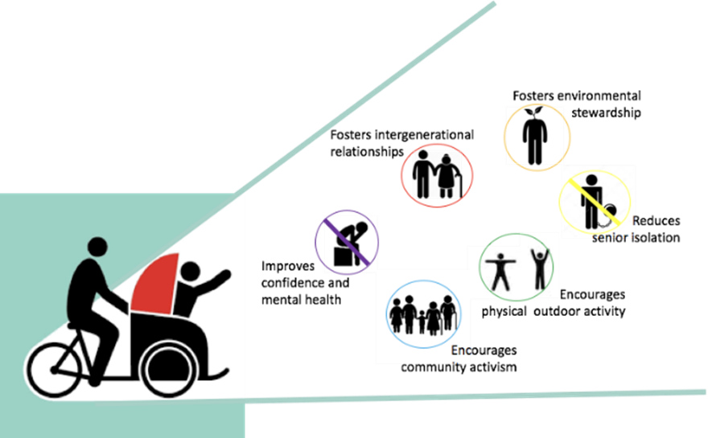
Benefits of the CWA HoCo Program
Enhanced Well-being
Riding in a trishaw promotes physical activity without exertion. The gentle movement can improve circulation, boost mood, and enhance overall well-being.
Social Connection
Our program fosters social interaction among participants, reducing feelings of isolation often experienced by seniors and those with limited mobility. Building friendships enhances mental health and creates a sense of belonging.
Access to Nature
Experience the beauty of HoCo trails and nature firsthand! Regular exposure to outdoor environments has been shown to reduce stress levels, improve mood, and promote relaxation.
Empowerment Through Mobility
For many individuals with limited mobility, traditional cycling may not be an option. Our trishaws provide an accessible alternative that empowers riders to explore their surroundings freely.
Support for Veterans
We honor our veterans by offering them a chance to engage with their community while enjoying therapeutic rides that promote relaxation and camaraderie.
Volunteering Opportunities
At CWA HoCo we will become part of something bigger! Volunteers are essential to our program's success—helping pilot trishaws not only benefits riders but also enriches the lives of those who give their time.
Intergenerational Connections
Our program encourages interactions between different generations and diverse groups, creating opportunities for storytelling, mentorship, and shared experiences that benefit both young volunteers and older riders.
Promoting Active Lifestyles
By participating in our rides or volunteering as pilots, you contribute to the HoCo culture of Age-Friendly initiative that values active living at any age—a crucial aspect of maintaining health as we grow older.

Slide 4
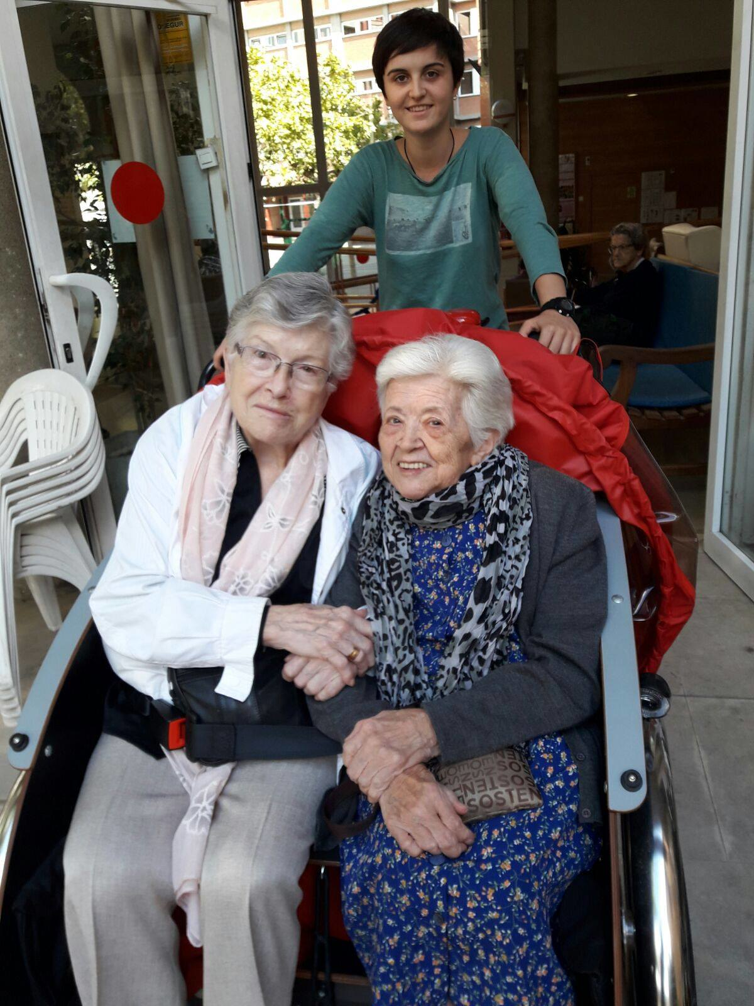
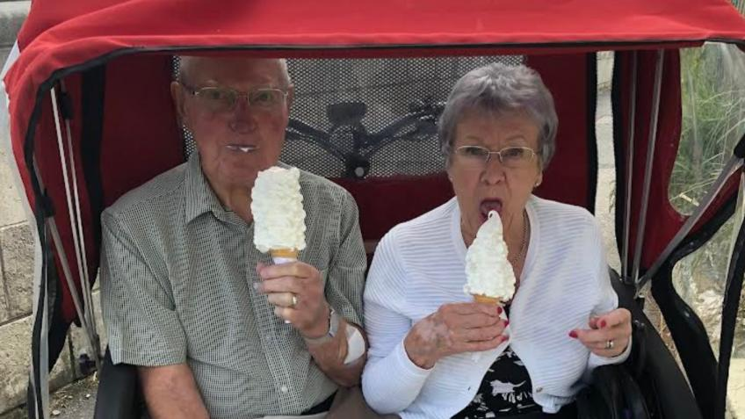
I want to help CWA HoCo, but I do not know how?
Here are several ways that you can help!
As a PILOT, HOST SENIOR CENTER, VOLUNTEER, or SPONSOR!
Be a PILOT you get a ride with some awesome residents!

Slide 5
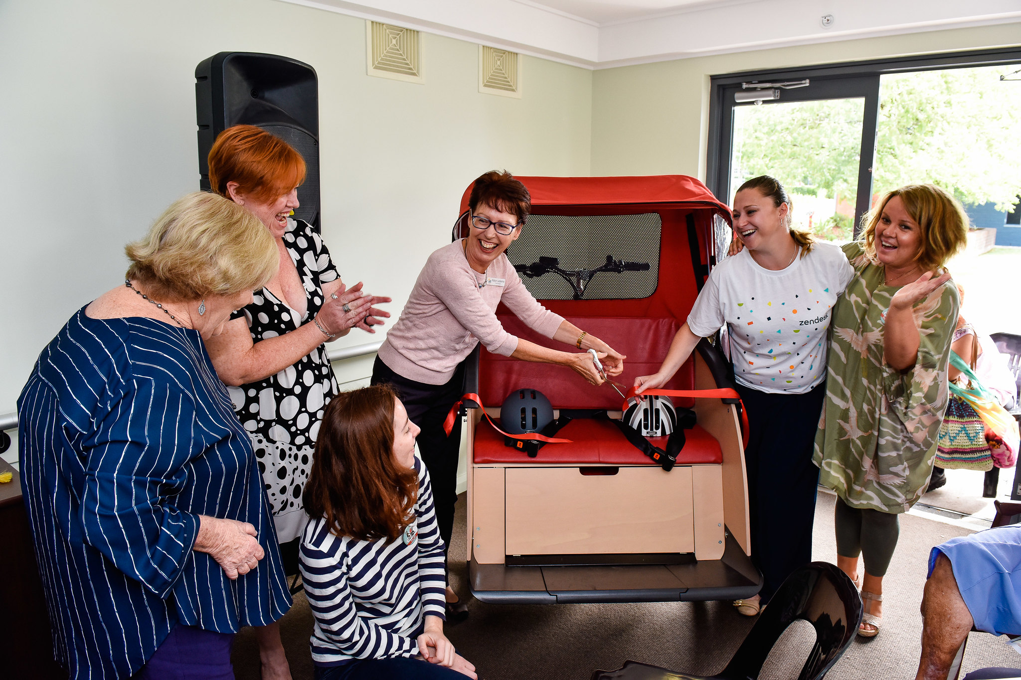
Be a HOST SENIOR CENTER, you let us ride with your community

Slide 6
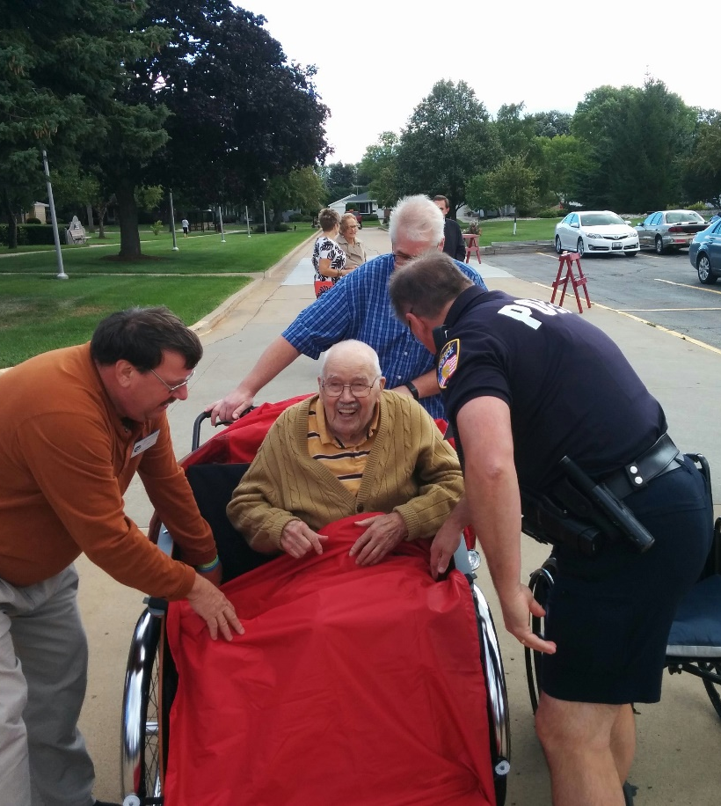
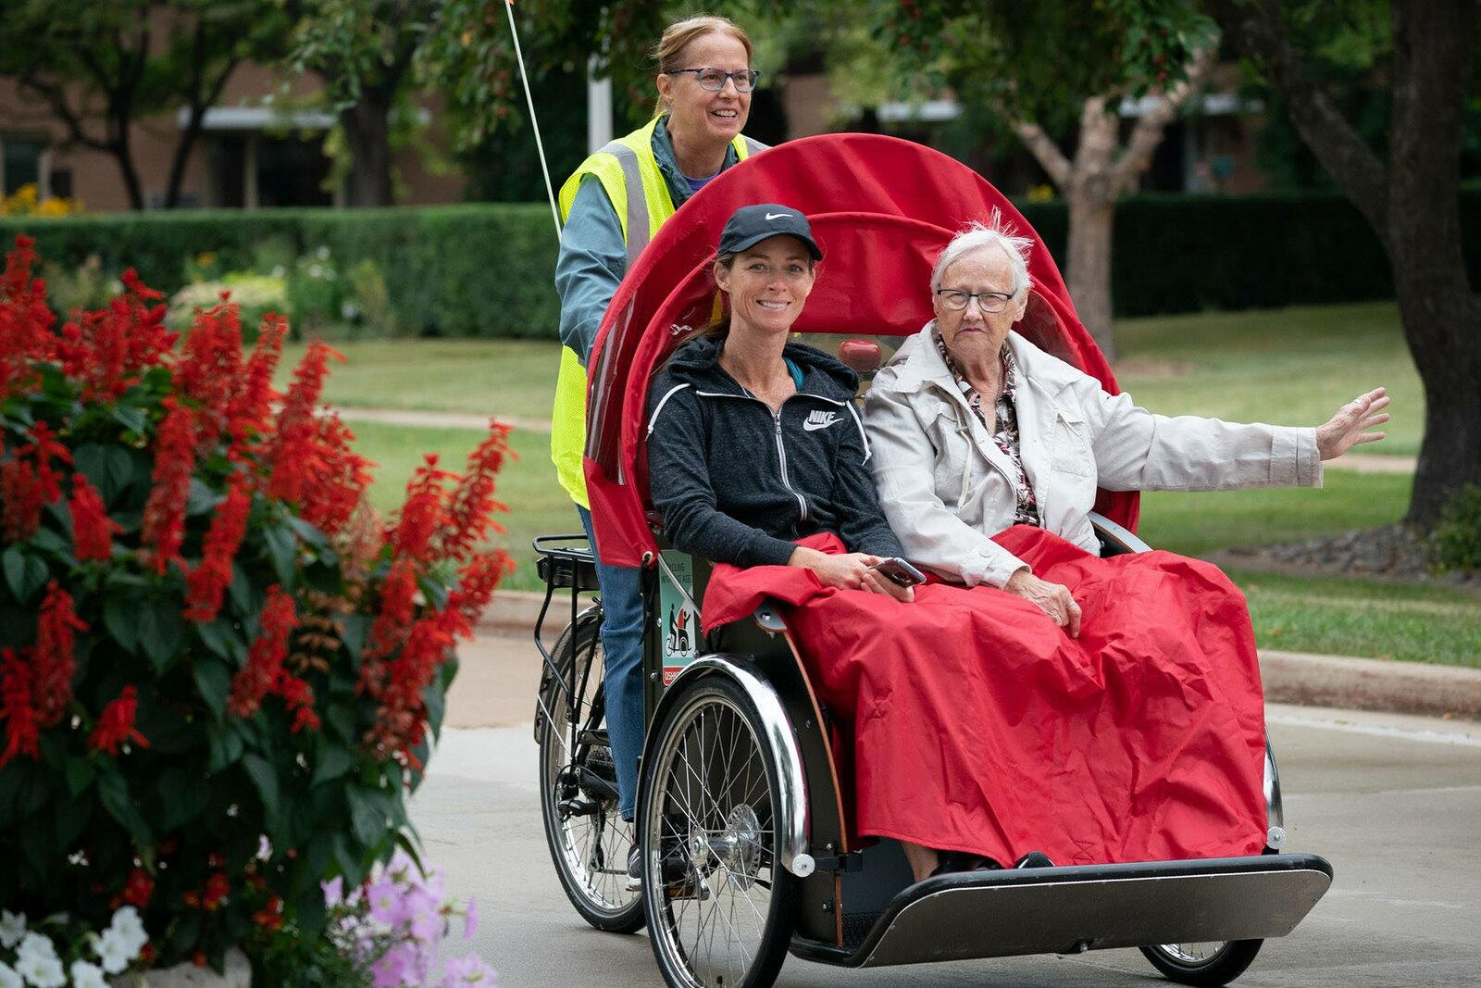
Be a VOLUNTEER you get to be a lawyer, a mechanic or a cheerleader.

Slide 7
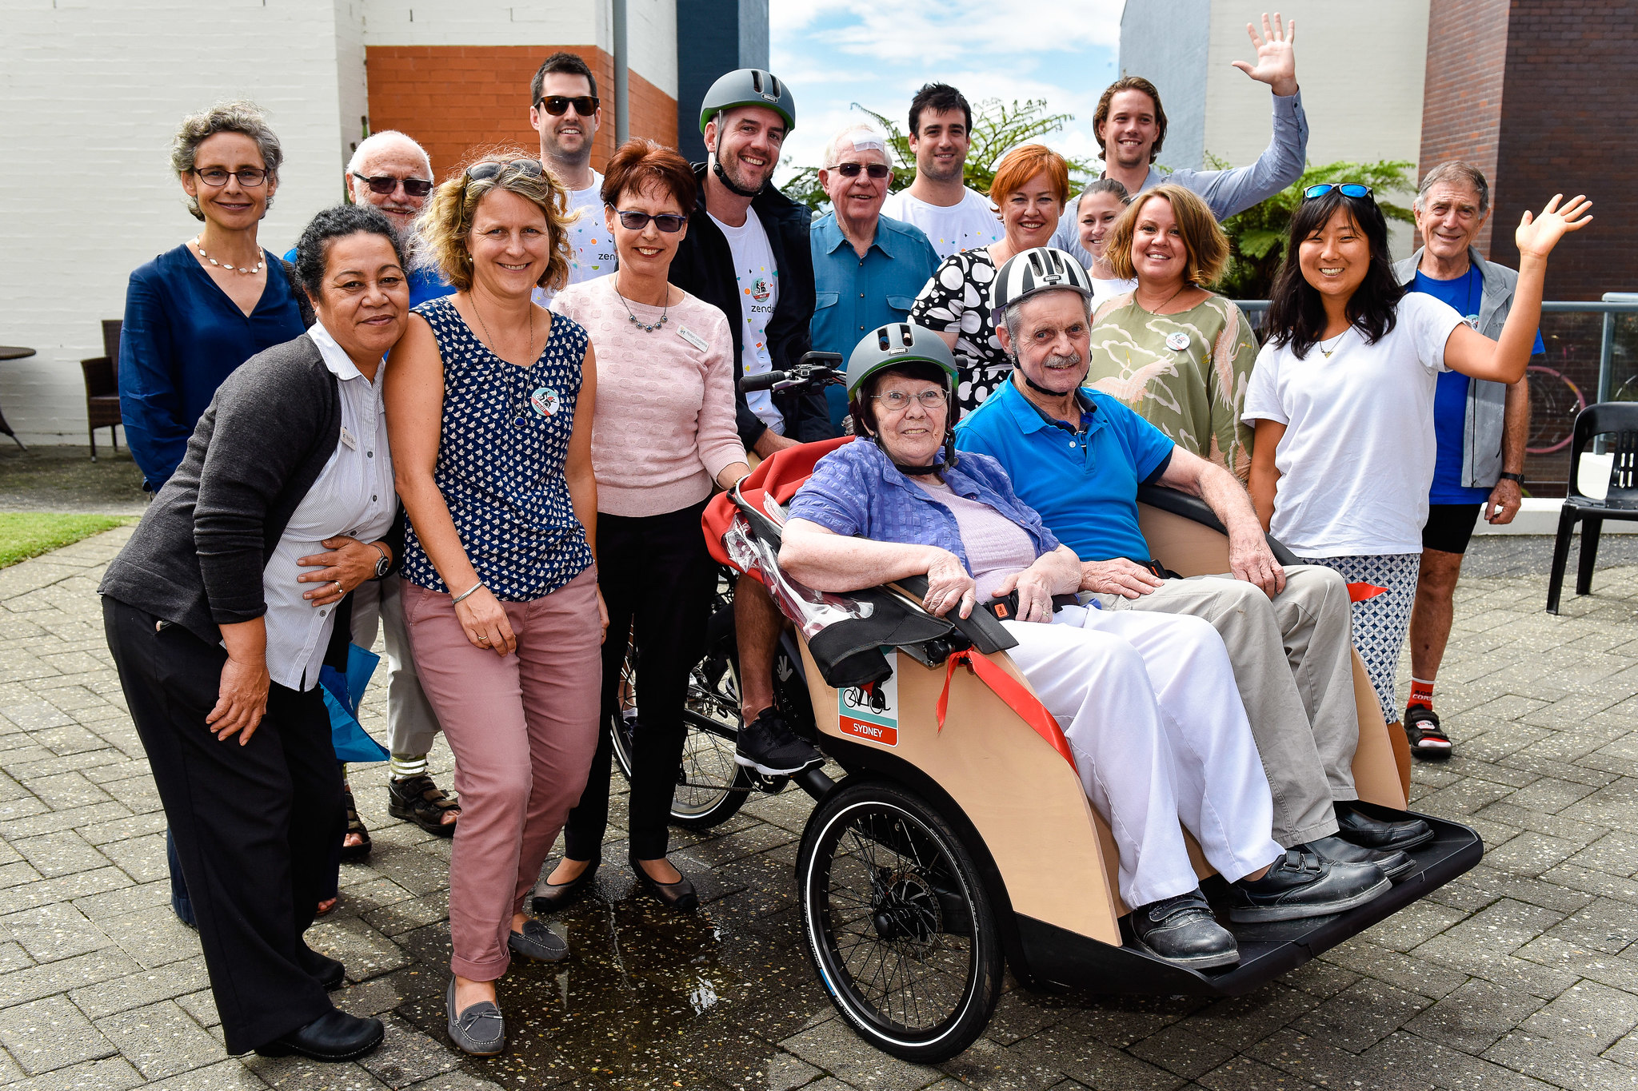
Be a SPONSOR smiles on you!
Sponsorship Include:
Sponsorships: Financial or in-kind support for our rides or events.
Event Hosting: Co-host community events that promote cycling and wellness.
Resource Provision: Donations of materials or services to enhance our rides.
Employee Volunteer Programs: Encourage staff participation as pilot riders or event helpers.
Cross-Promotion: Feature CWA in your marketing materials or social media.
I would love to discuss how we can work together to promote health and happiness within our community. Please feel free to reach out via email or phone at your convenience.

Slide 8
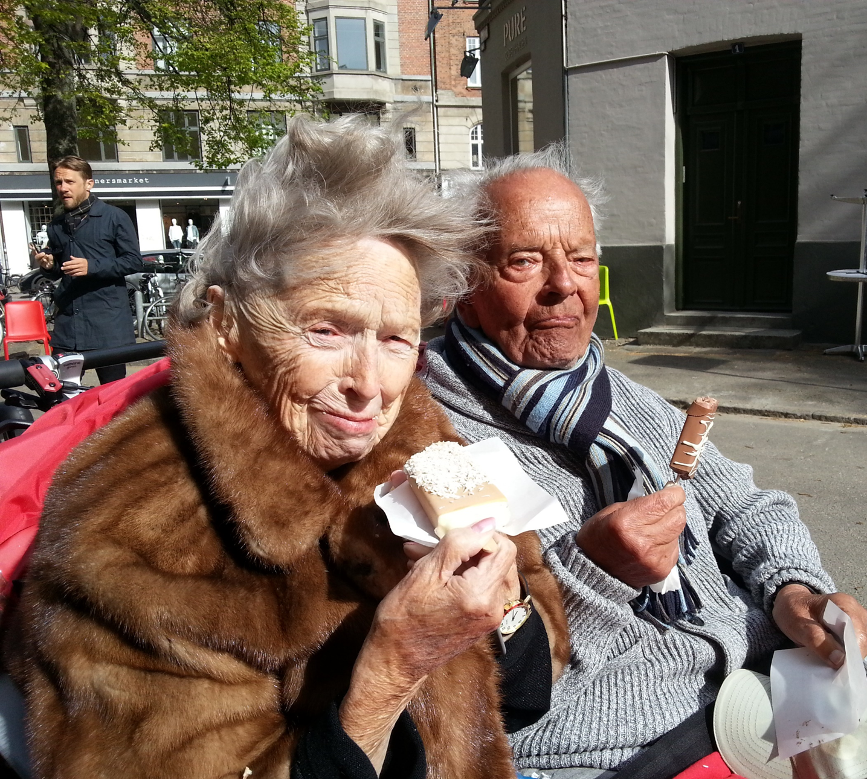
Get Involved!
Are you ready to CWA HoCo experience the joy of cycling? Are you ready to become a volunteer?
Whether you want to participate as a rider or volunteer as a pilot, we invite you to join us on this exciting journey! Together, we can create lasting memories while promoting inclusivity in our community. For more information about how you can get involved or support our mission, please contact us today!
Donations!
Wants to donate? Please visit our FundPage site at ___
Let’s give and share the right to feel the wind in the hair of our residents!!

Slide 9
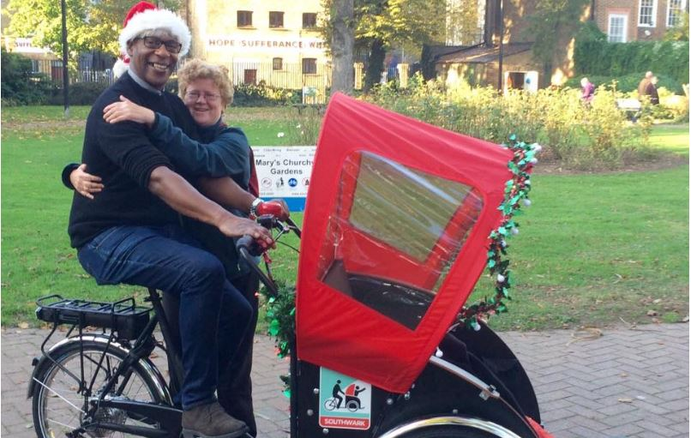
Want to know more about Cycling Without Age?
Main website
Short informative videos
Amazing Humans, Scotland
Singapore
The Great Escape
PBS video
Riding through time

